Slide 1
Measures of Central Tendency (2)
Md. Ismail Hossain Riday

Slide 2
Measures of Location
We have learned that median divided a set of data into two equal parts.
In the same way, we can divides a set of data into
Four equal parts
Ten equal parts
Hundred equal parts
Quartiles
Deciles
Percentiles

Slide 3
Q, D, and P
Quartiles: Divide the data set into four equal parts. So, we get 3 quartile points: Q1, Q2, and Q3
Deciles: Divide the data set into ten equal parts. So, we get 9 decile points: D1, D2, D3, … , D9.
Percentiles: Divide the data set into hundred equal parts. So, we get 99 percentile points: P1, P2, P3, … , P99

Slide 4


$$Q_{1}=1st Quartile=25\% or Smallest 25\%=Largest 75\%$$
$$Q_{2}=2nd Quartile=50\% or Smallest 50\%=Largest 50\%$$
$$Q_{3}=3rd Quartile=75\% or Smallest 75\%=Largest 25\%$$
$$D_{1}=1st Decile=10\% or Smallest 10\%=Largest 90\%$$
$$D_{2}=2nd Decile=20\% or Smallest 20\%=Largest 80\%$$
$$………$$
$$D_{9}=9th Decile=90\% or Smallest 90\%=Largest 10\%$$
$$P_{1}=1st Percentile=1\% or Smallest 1\%=Largest 99\%$$
$$P_{2}=2nd Percentile=2\% or Smallest 2\%=Largest 98\%$$
$$………$$
$$P_{99}=99th Percentile=99\% or Smallest 99\%=Largest 1\%$$

Slide 5
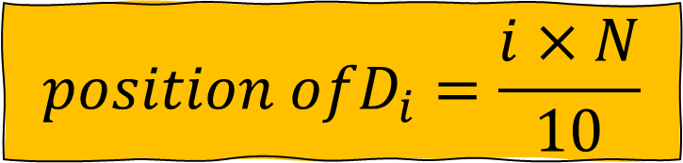
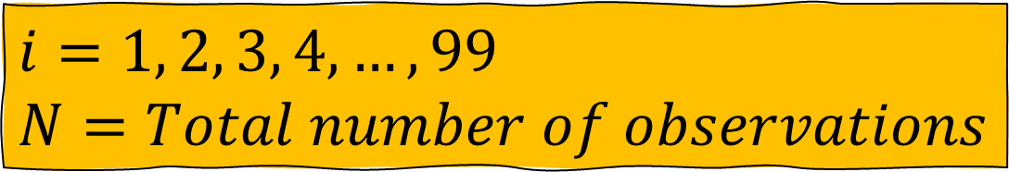
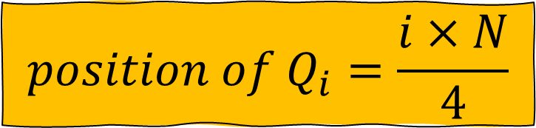
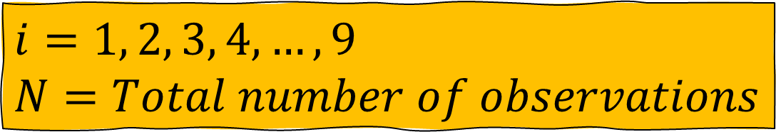
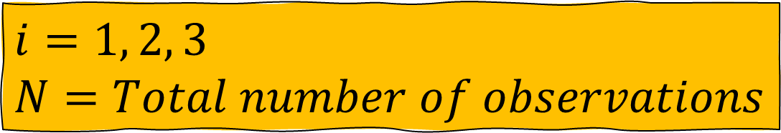

Q, D, and P (Ungrouped)
$$position of Q_{i}=\frac{i×N}{4}$$
$i=1, 2, 3$
$N=Total number of observations$
$${position ofD}_{i}=\frac{i×N}{10}$$
$i=1, 2, 3, 4, …,9$
$N=Total number of observations$
$${position ofP}_{i}=\frac{i×N}{100}$$
$i=1, 2, 3, 4, …,99$
$N=Total number of observations$

Slide 6
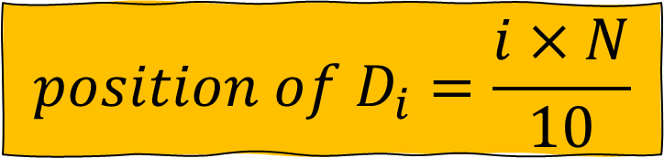
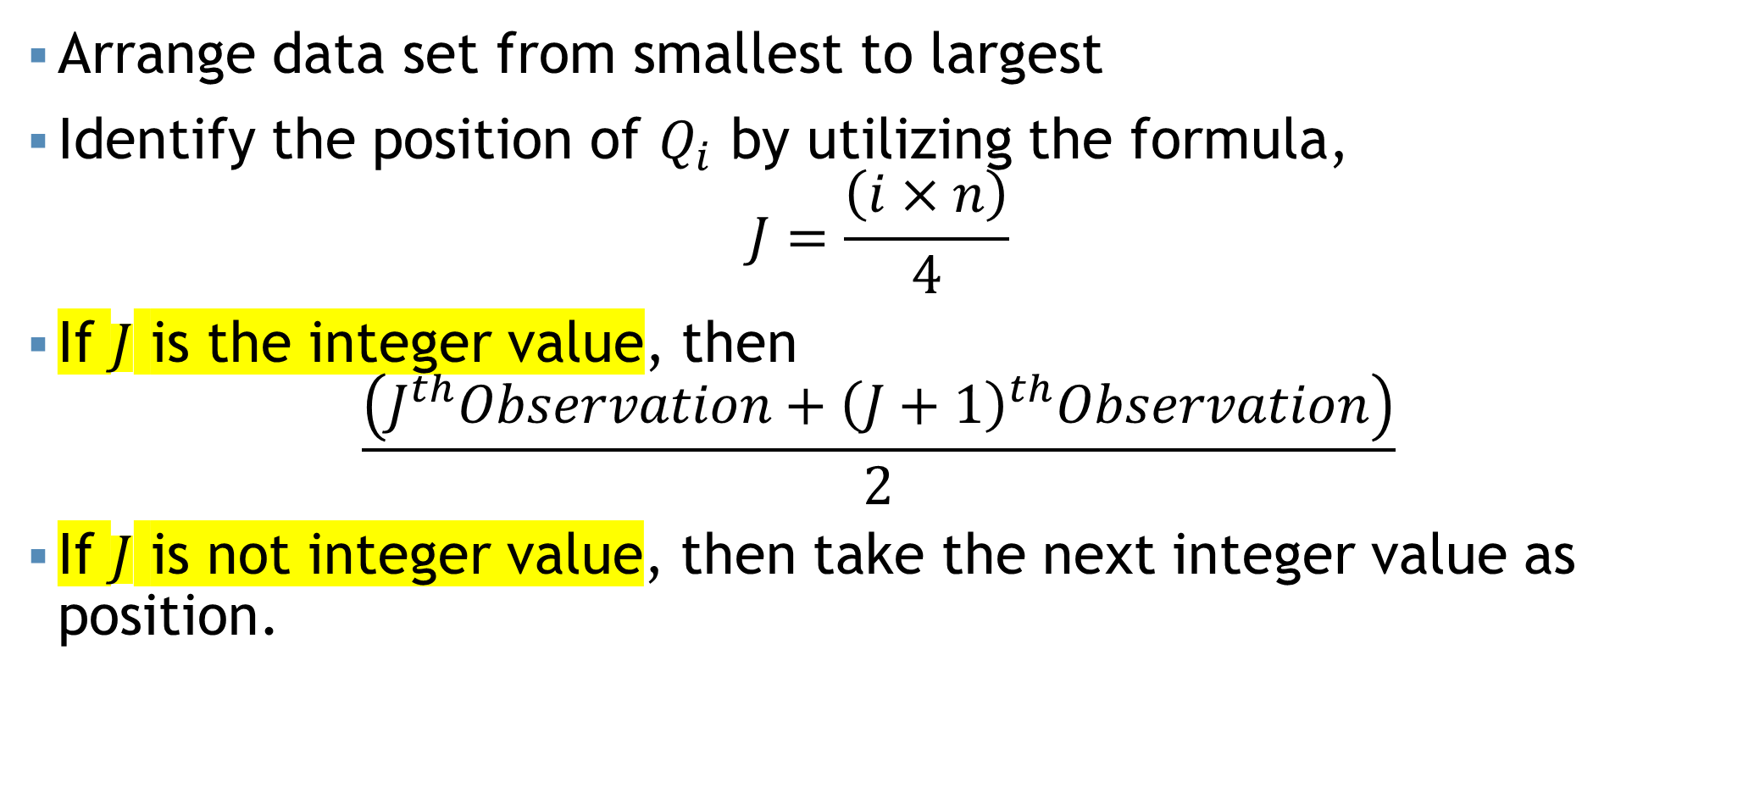

Steps…
$$position of D_{i}=\frac{i×N}{10}$$
$$position of P_{i}=\frac{i×N}{100}$$
Arrange data set from smallest to largest
Identify the position of $Q_{i}$ by utilizing the formula,
$$J=\frac{\left(i×n\right)}{4}$$
If $J$ is the integer value, then
$$\frac{\left(J^{th}Observation+{\left(J+1\right)}^{th}Observation\right)}{2}$$
If $J$ is not integer value, then take the next integer value as position.

Slide 7
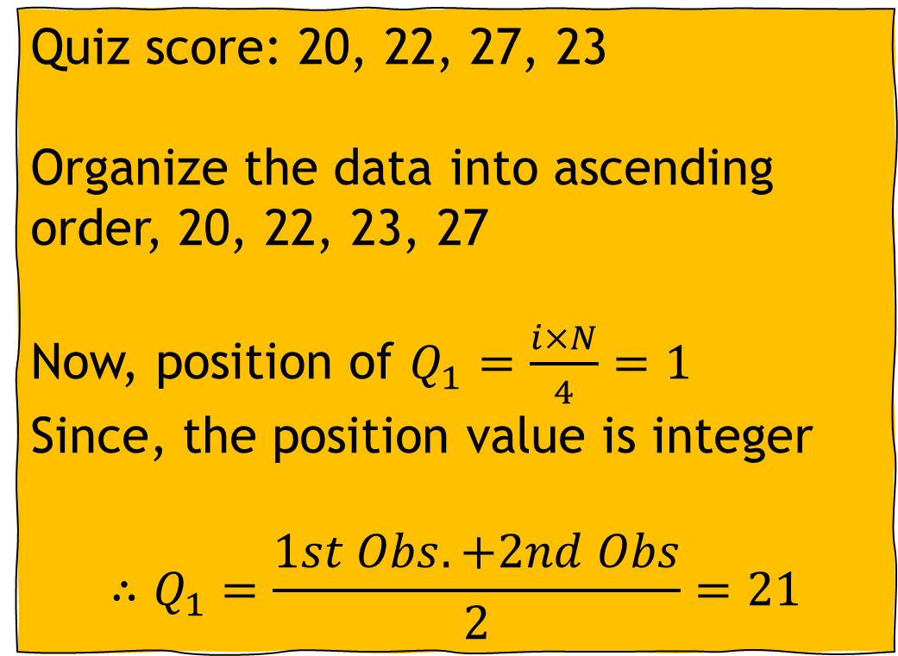
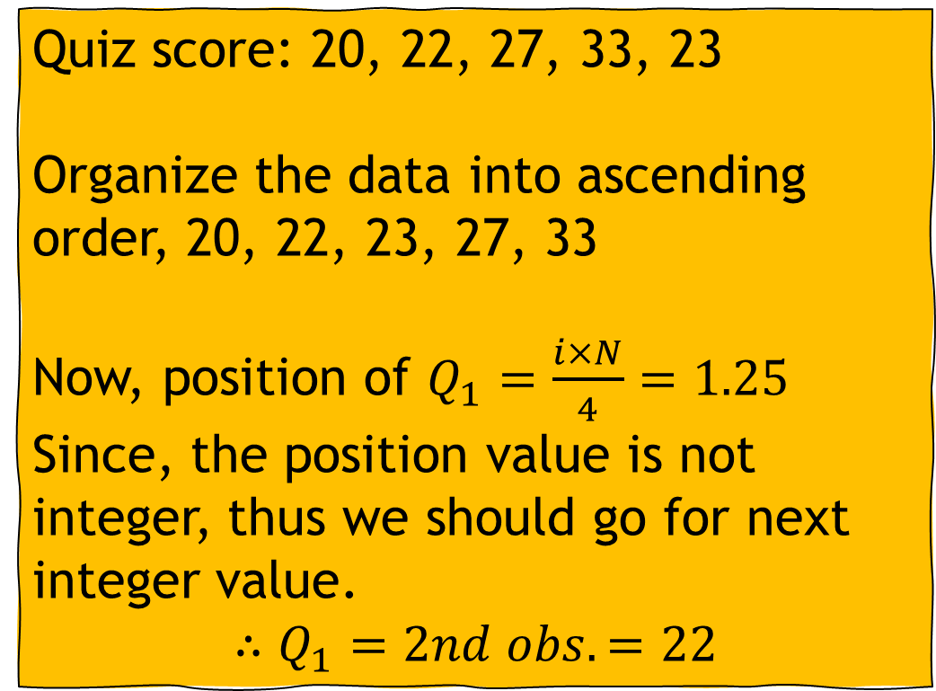
Example (Ungrouped)
Quiz score: 20, 22, 27, 33, 23
Organize the data into ascending order, 20, 22, 23, 27, 33
Now, position of $Q_{1}=\frac{i×N}{4}=1.25$
Since, the position value is not integer, thus we should go for next integer value.
$$∴Q_{1}=2nd obs.=22$$
Quiz score: 20, 22, 27, 23
Organize the data into ascending order, 20, 22, 23, 27
Now, position of $Q_{1}=\frac{i×N}{4}=1$
Since, the position value is integer
$$∴Q_{1}=\frac{1st Obs. +2nd Obs}{2}=21$$
It's evident that 25% of the students achieve scores of 22 or below, while 75% of the students attain scores above 22
It's evident that 25% of the students achieve scores of 21 or below, while 75% of the students attain scores above 21

Slide 8

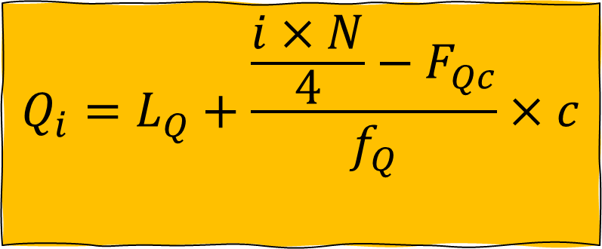
Q, D, and P (Grouped)
$$Q_{i}=L_{Q}+\frac{\frac{i×N}{4}−F_{Qc}}{f_{Q}}×c$$
$$L_{Q}=Lower limit of quartile class$$
$$N=Total number of observations$$
$$F_{c}=Cumultative frequency of pre quartile class$$
$$f_{Q}=Frequency of quartile class$$
$$c=Class interval$$

Slide 9
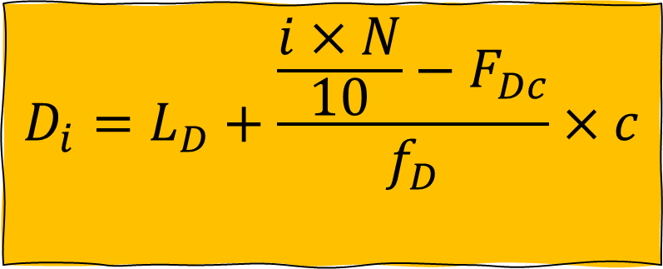
Q, D, and P (Grouped)
$$D_{i}=L_{D}+\frac{\frac{i×N}{10}−F_{Dc}}{f_{D}}×c$$
$$L_{D}=Lower limit of decile class$$
$$N=Total number of observations$$
$$F_{c}=Cumultative frequency of pre decile class$$
$$f_{D}=Frequency of decile class$$
$$c=Class interval$$

Slide 10
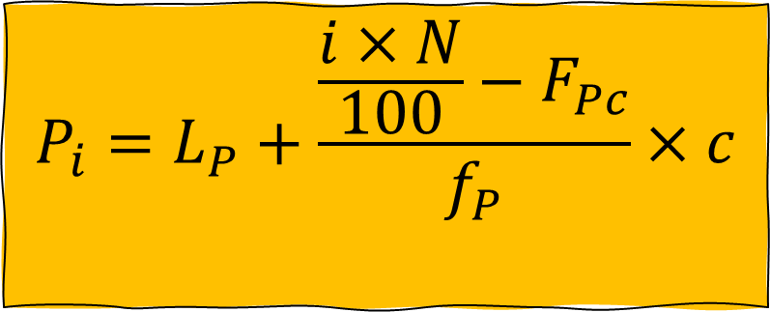
Q, D, and P (Grouped)
$$P_{i}=L_{P}+\frac{\frac{i×N}{100}−F_{Pc}}{f_{P}}×c$$
$$L_{P}=Lower limit of percentile class$$
$$N=Total number of observations$$
$$F_{c}=Cumultative frequency of pre percentile class$$
$$f_{P}=Frequency of percentile class$$
$$c=Class interval$$

Slide 11

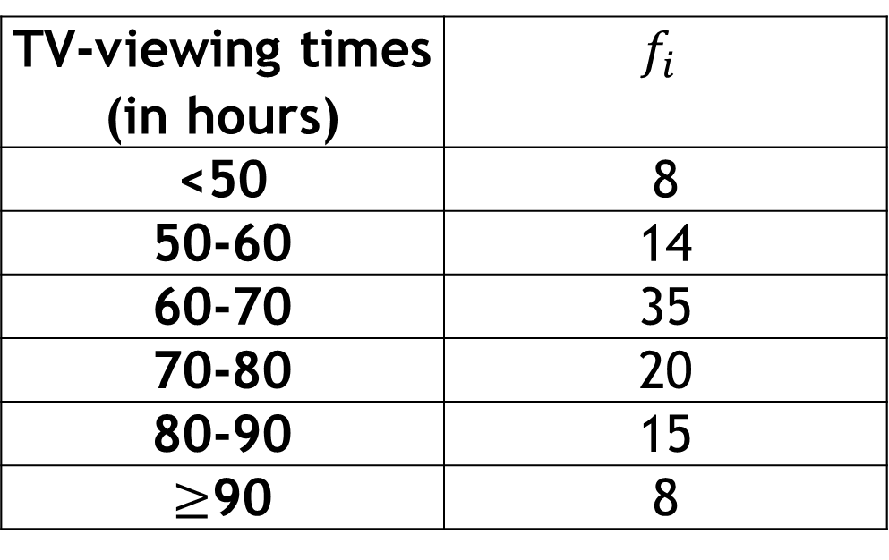
Self Practice!!!
$$\text{Determine} Q_{1}, Q_{2}, and Q_{3} \text{with} \text{interpretation}\text{.}$$
A social organization publishes information on the TV-viewing habits of Bangladeshi garments workers in a report on Television. A sample of 100 garments workers yielded the monthly viewing times, in hours, displayed on the table,
Ans: 60.9, 68, and 79
TV-viewing times (in hours) | $$f_{i}$$
<50 | 8
50-60 | 14
60-70 | 35
70-80 | 20
80-90 | 15
$≥$90 | 8

Slide 12
Self Practice!!!
a. Construct a table and calculate frequency from this ogive curve.
b. Using table from (a), calculate the mean, median, mode.

Slide 13
Mathematical exercise
To access additional mathematical problems, please refer to the PDF lecture notes and Books.

Slide 14
Thank You

